Slide 1



Reproducible
deep learning
PhD Course in Data Science
Lecturer: Simone Scardapane
Important!
Where’s my code?
Lecture 1: Introduction
set_seed(6531463)
code_final_v4_r3_simone.py
learning_rate=0.00413

Slide 2
Introduction
Who needs reproducibility
… when you can have Google Colab?

Slide 3
Reproducibility is the hallmark of modern science …
… yet, complete code reproducibility in deep learning is surprisingly hard!

Slide 4
Think of how many times we need reproducibility:
Collaboration with other researchers why is your code not working?
Replicating some experiments after a review why is MY code not working?
Running your code on a different environment (cloud, GPU server, …).
Experimenting on an unstable code (e.g., research logs …).

Slide 5
In fact, reproducibility is a major concern in machine learning research today:
Quantifying Independently Reproducible Machine Learning
5 – Reproducibility – Machine Learning Blog | ML@CMU | Carnegie Mellon University
Reproducibility of Machine Learning Models in Health Care
Missing data hinder replication of artificial intelligence studies
Papers with Code - ML Reproducibility Challenge Spring 2021 Edition
Unreproducible Research is Reproducible

Slide 6
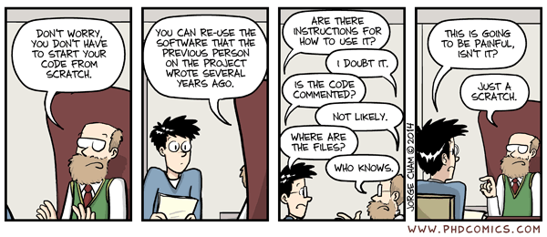
PHD Comics: The Muon g-2 Anomaly Explained

Slide 7
Sources of headaches include (but are not limited to):
Environment mismatches (missing libraries, versions, …).
Small architectural changes who modified my default hyper-parameters?
Untracked changes in the data or preprocessing routines.
“Silent” bugs in the code (very common in deep learning!). Example: Using PyTorch + NumPy? You're making a mistake.
… a different random seed?

Slide 8
Solving all these problems requires a lot of tooling:
Code versioning to track code changes.
Data versioning to track data changes.
Logging and monitoring for experiments.
Environment isolation (dockerization).
Unit testing and continuous integration.
A number of disciplines (e.g., MLOps) are devoted to handling the lifecycle of a ML project.

Slide 9
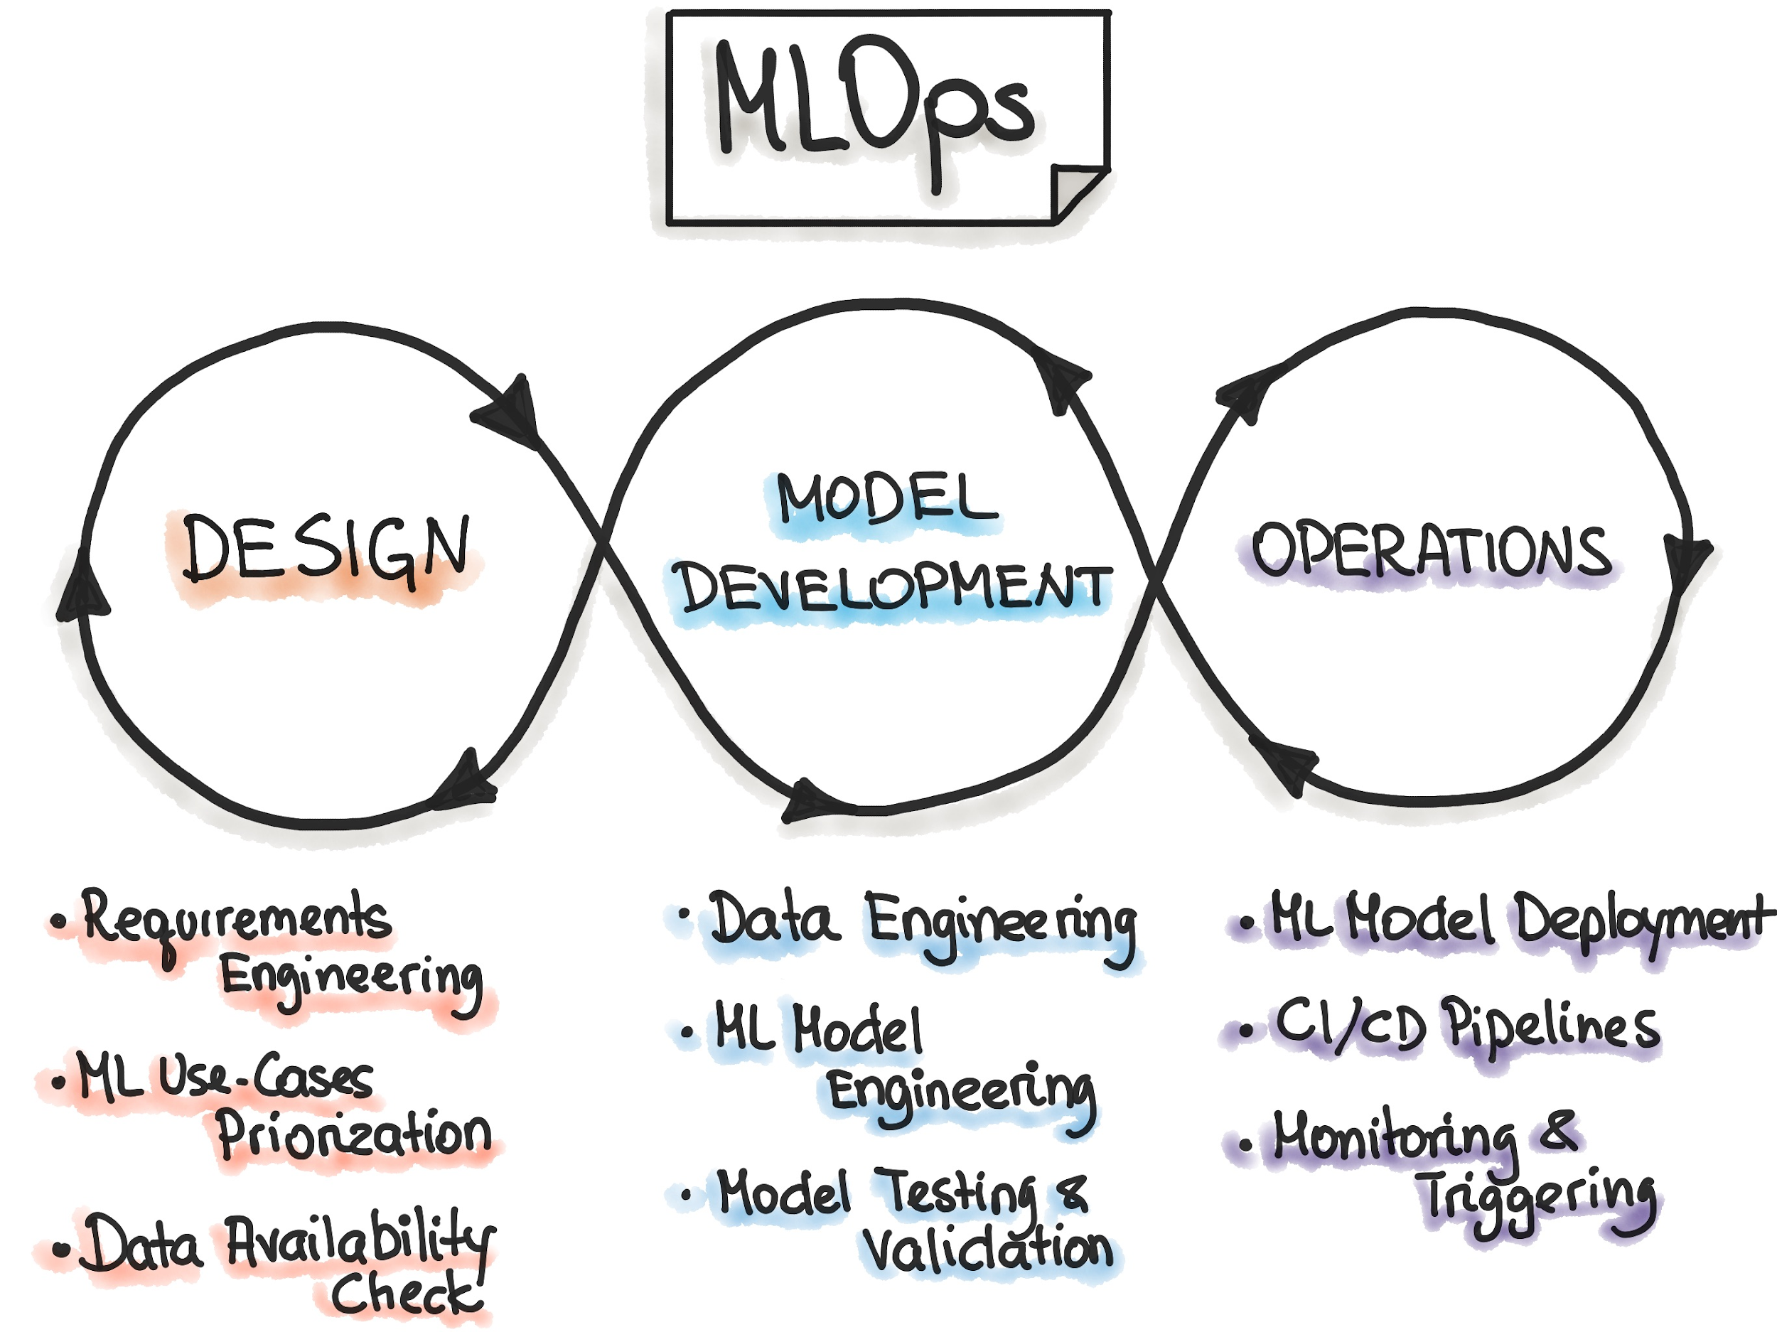
https://ml-ops.org/content/mlops-principles#iterative-incremental-process-in-mlops

Slide 10
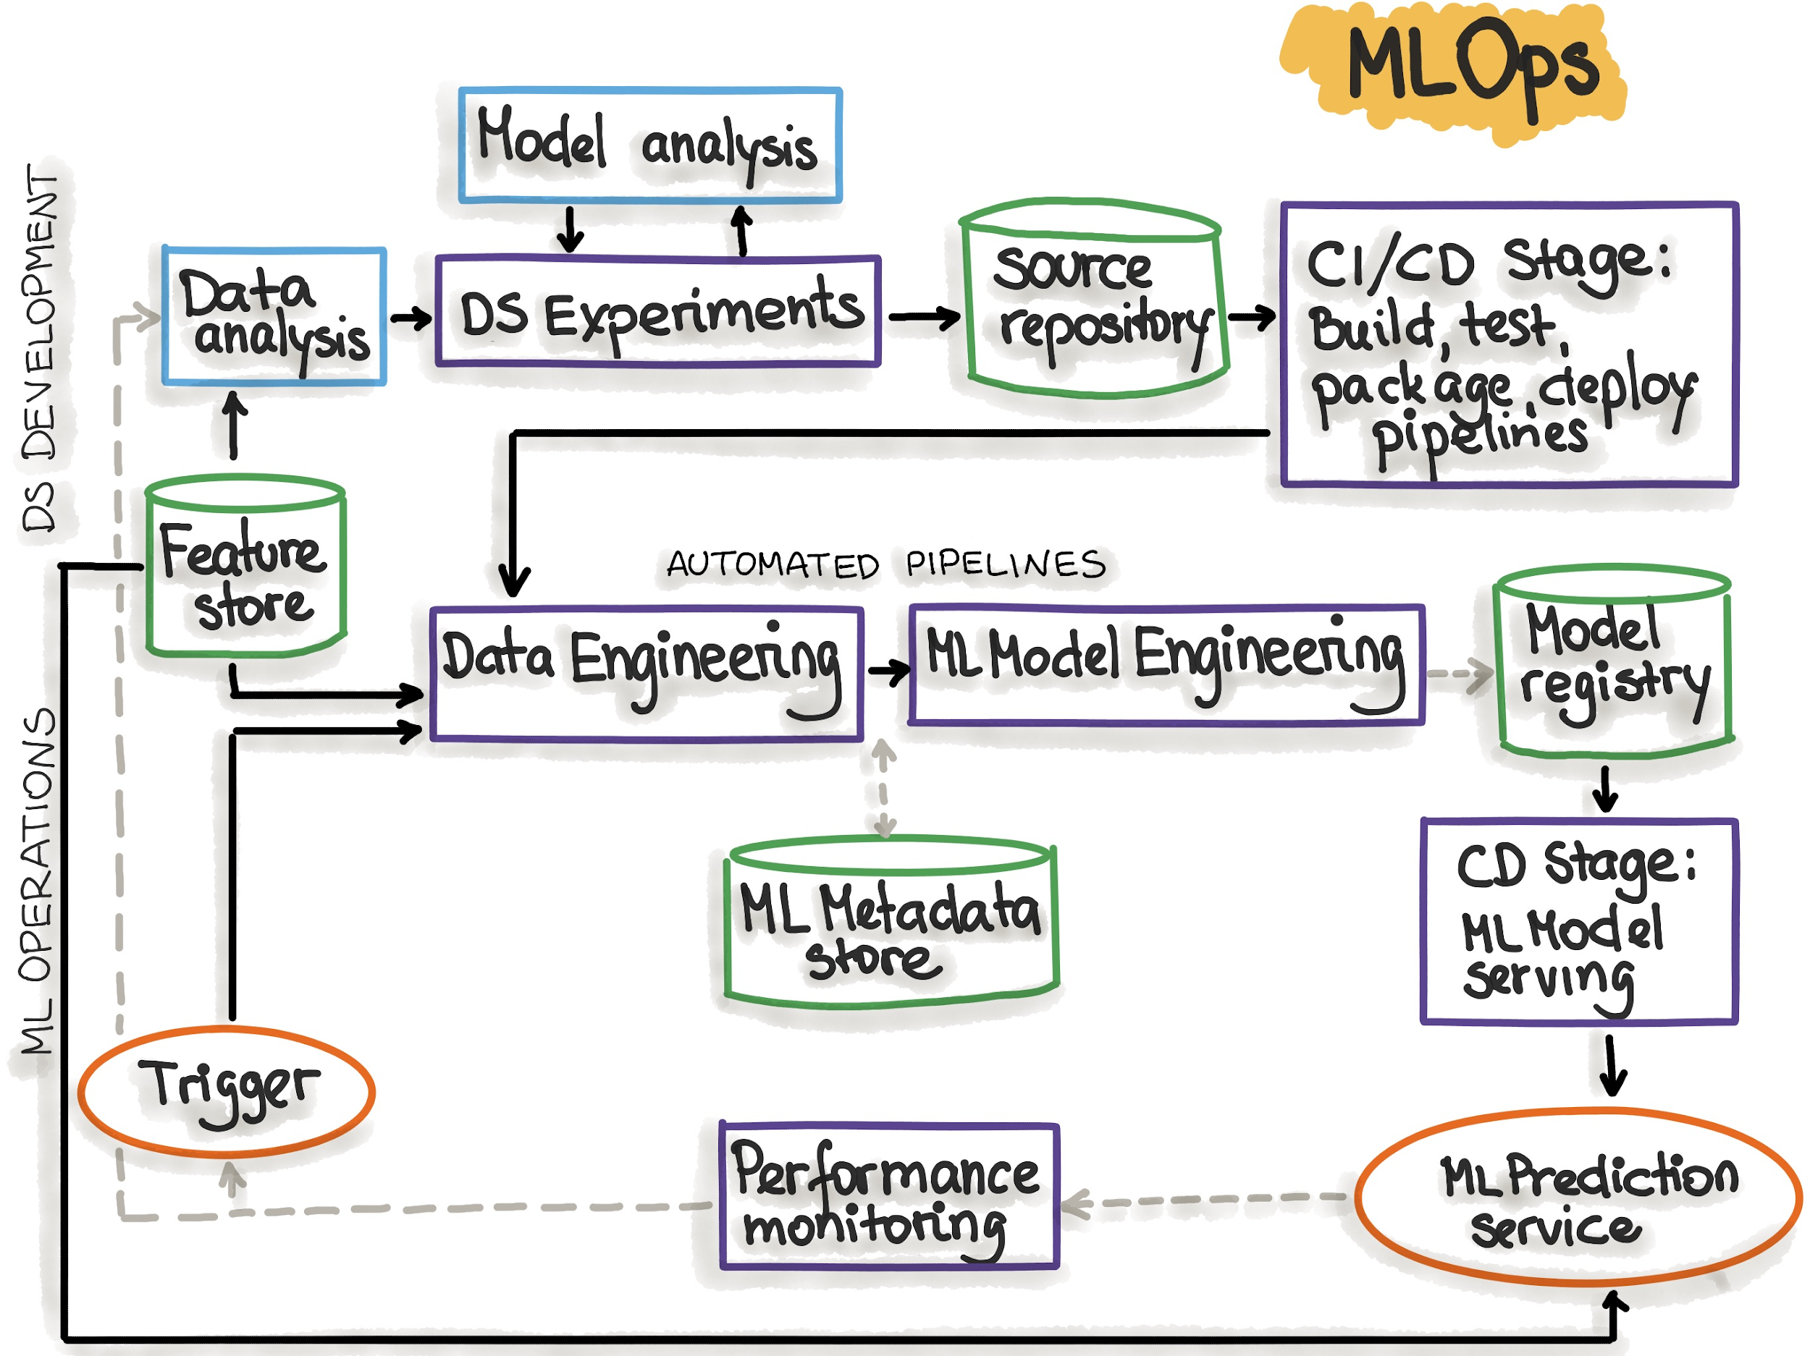
https://ml-ops.org/content/mlops-principles#iterative-incremental-process-in-mlops

Slide 11
Introduction
Overview of the course

Slide 12
Starting from a simple notebook running a deep learning model, we will build a (hopefully) reproducible environment by including a number of useful libraries and tools.

Slide 13
The number of MLOps libraries is, simply put, staggering.
In the course, we focus on libraries that are as much as possible open-source, simple, well-contained.
This is a biased selection, and you are free to experiment as much as you want!

Slide 14
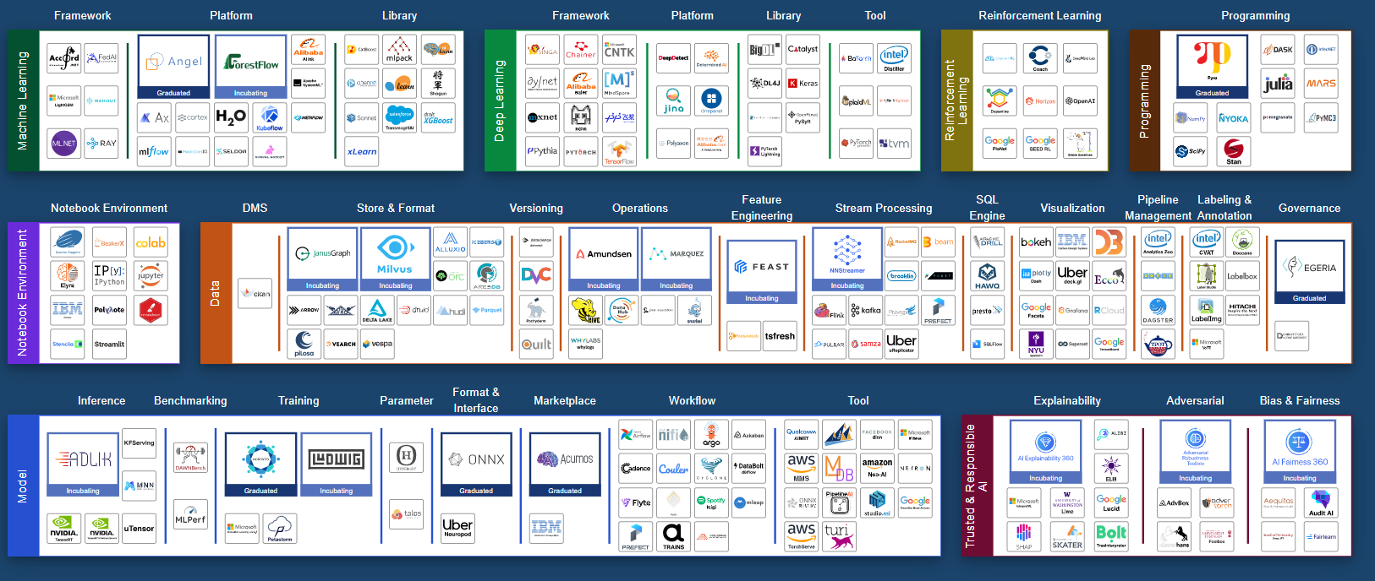
kelvins/awesome-mlops: A curated list of awesome MLOps tools
LF AI & Data Landscape

Slide 15
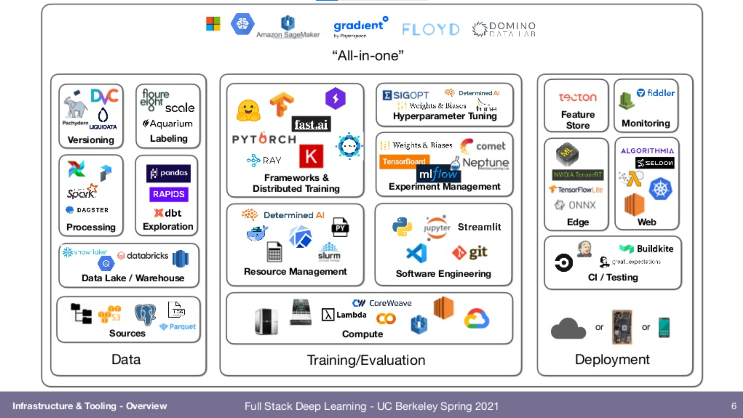
Lecture 6: Infrastructure & Tooling

Slide 16










Tuner
LECTURE 2
Runnable image
Logger
LECTURE 3
train.py
.dockerfile
config.yaml
continuous integration
.git
data.dvc
requirements.txt
LECTURE 4
dvc pull
git push
Local
Git service
LECTURE 1
LECTURE 1

Slide 17
What this course is not about:
Not about putting models into production (no Kubernetes, Kubeflow, …).
Not about handling data pipelines (e.g., no feature stores).
It is not about end-to-end frameworks (see Lecture 6: Infrastructure & Tooling for overview).
This is also not about best practices to make deep learning models work. For that, see A Recipe for Training Neural Networks

Slide 18
Introduction
A recap on deep learning

Slide 19
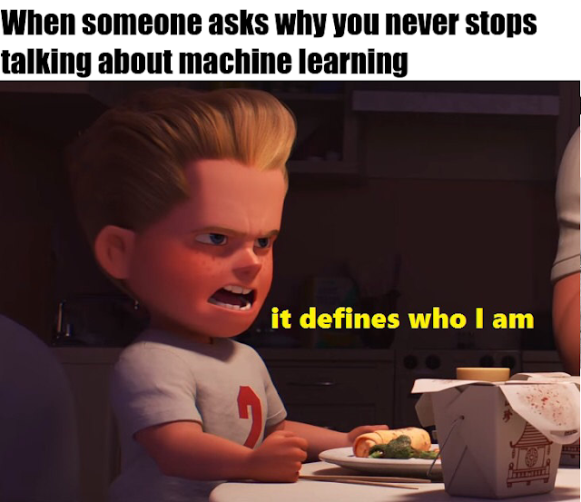

Slide 20
At a high level, machine learning is about learning functions from some training data.
Deep learning models are a class of methods defined by high modularity and the possibility of easily handling many types of data (images, sequences, videos, …).
Stochastic gradient descent (SGD) is the most common approach to train these models

Slide 21
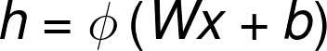
A simple model defined on a vector:
Some weights are trainable (W, b), some are hyper-parameters (e.g., the choice of non-linearity).

Slide 22
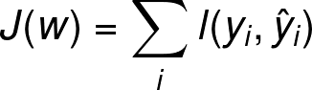

After a model is built, define a loss function:
And optimize it using some variant of stochastic gradient descent:

Slide 23
Set-up your environment using the instructions from the website:
https://www.sscardapane.it/teaching/reproducibledl/#setup-your-machine
As use case, we will implement a simple convolutional neural network for classifying environmental sounds: karolpiczak/ESC-50: ESC-50: Dataset for Environmental Sound Classification

